Slide 1
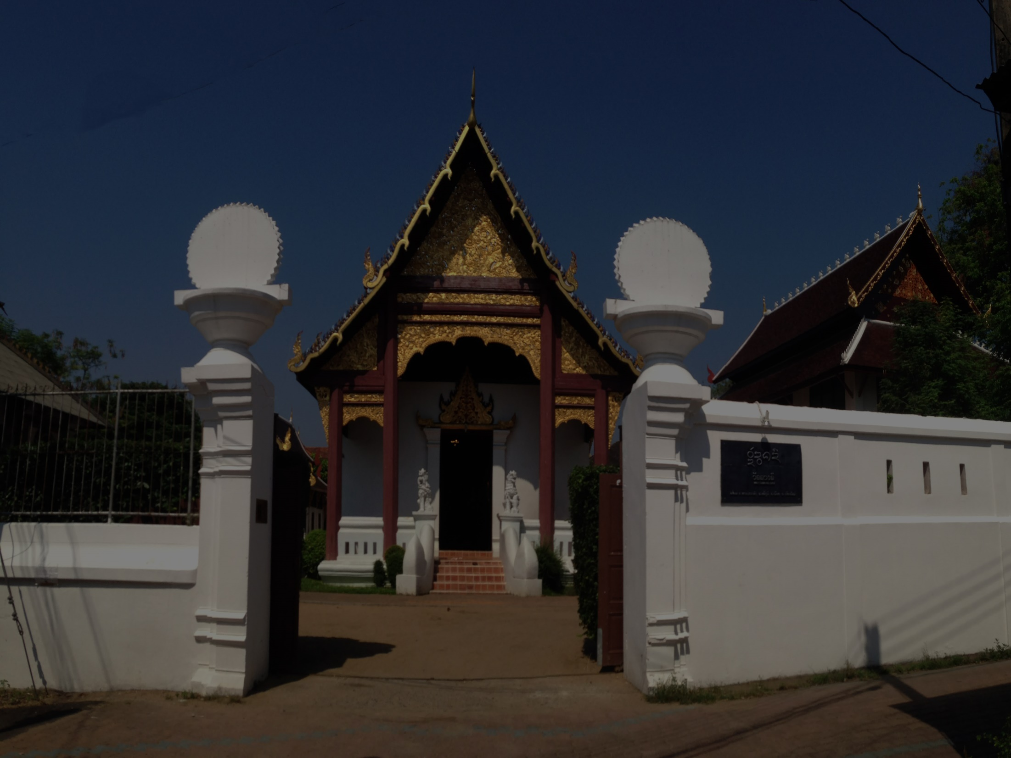
Duangdee Temple
SE323 & SE331 Project
Web Application (MVC)

Slide 2

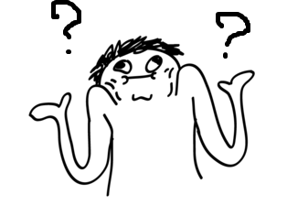
Group : No Idea
Member
1.Tanawan Fuangthura 552115031
2.Pornpat Tanjitanont 552115047
3.Pattadon Prapin 552115049
4.Zhiyi Yang 542115512

Slide 3
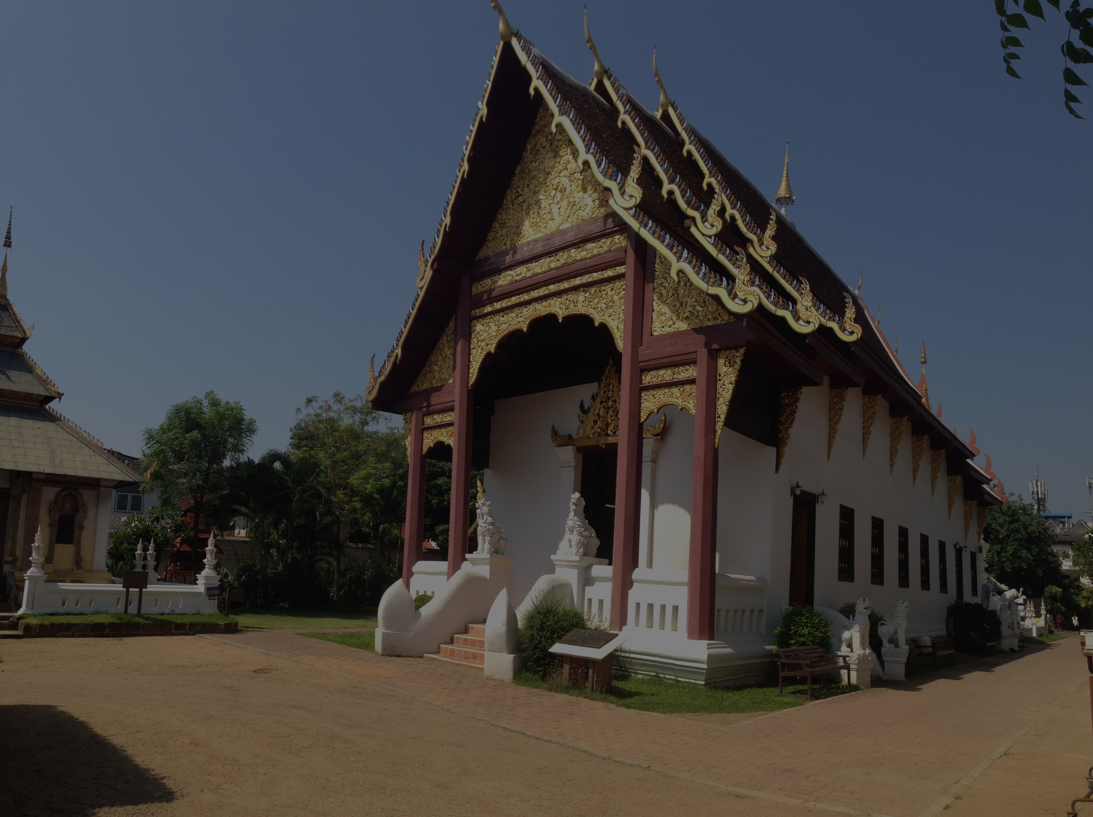
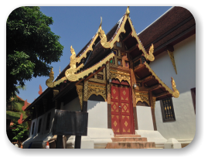
Introduce to the project

Slide 4
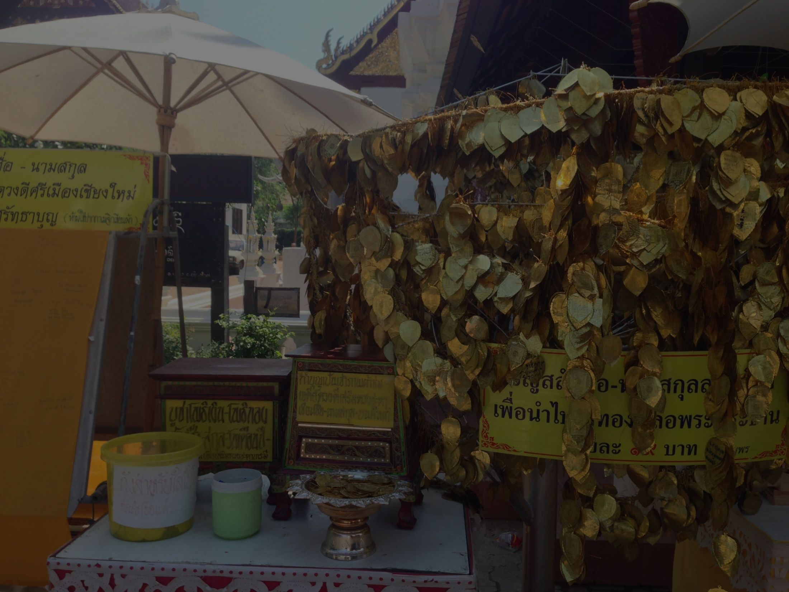
Features (User)
-Register new account
-Log in as a member
-View history of the temple
-Read news of the temple
-View activities of the temple
-View contact details of the temple
-View gallery of the temple

Slide 5
Features (User)
-Link to facebook page of the temple
-Receive news & activities via email
-Post Q&A in forums
-View/Edit/Delete post in forums
-Comment on the post in forums
-View/Edit/Delete comments in the post
-Log out from the website

Slide 6
Features (Admin)
-Log in as administrator
-Add/Edit/Delete news of the temple
-Add/Edit/Delete activities of the temple
-Edit all contents in the website
-Log out from the website

Slide 7
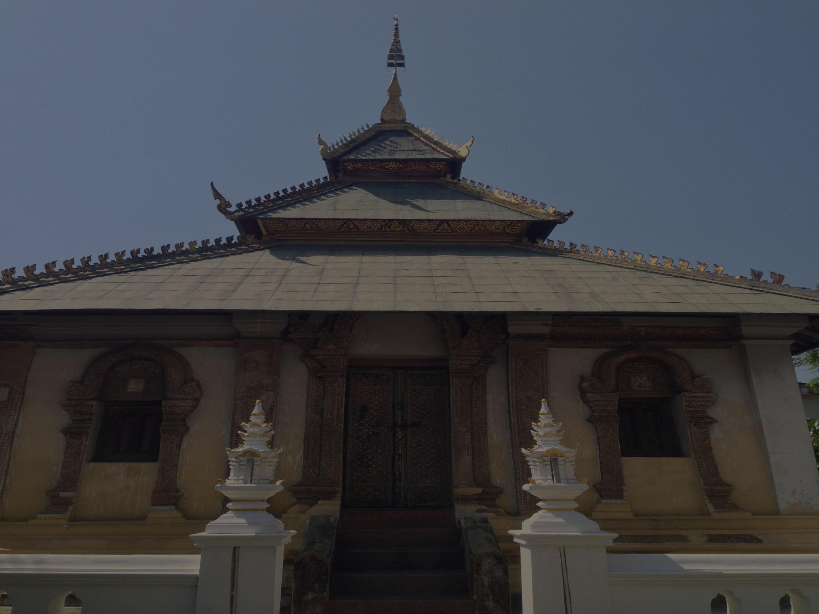
URS & SRS

Slide 8
URS & SRS

Slide 9
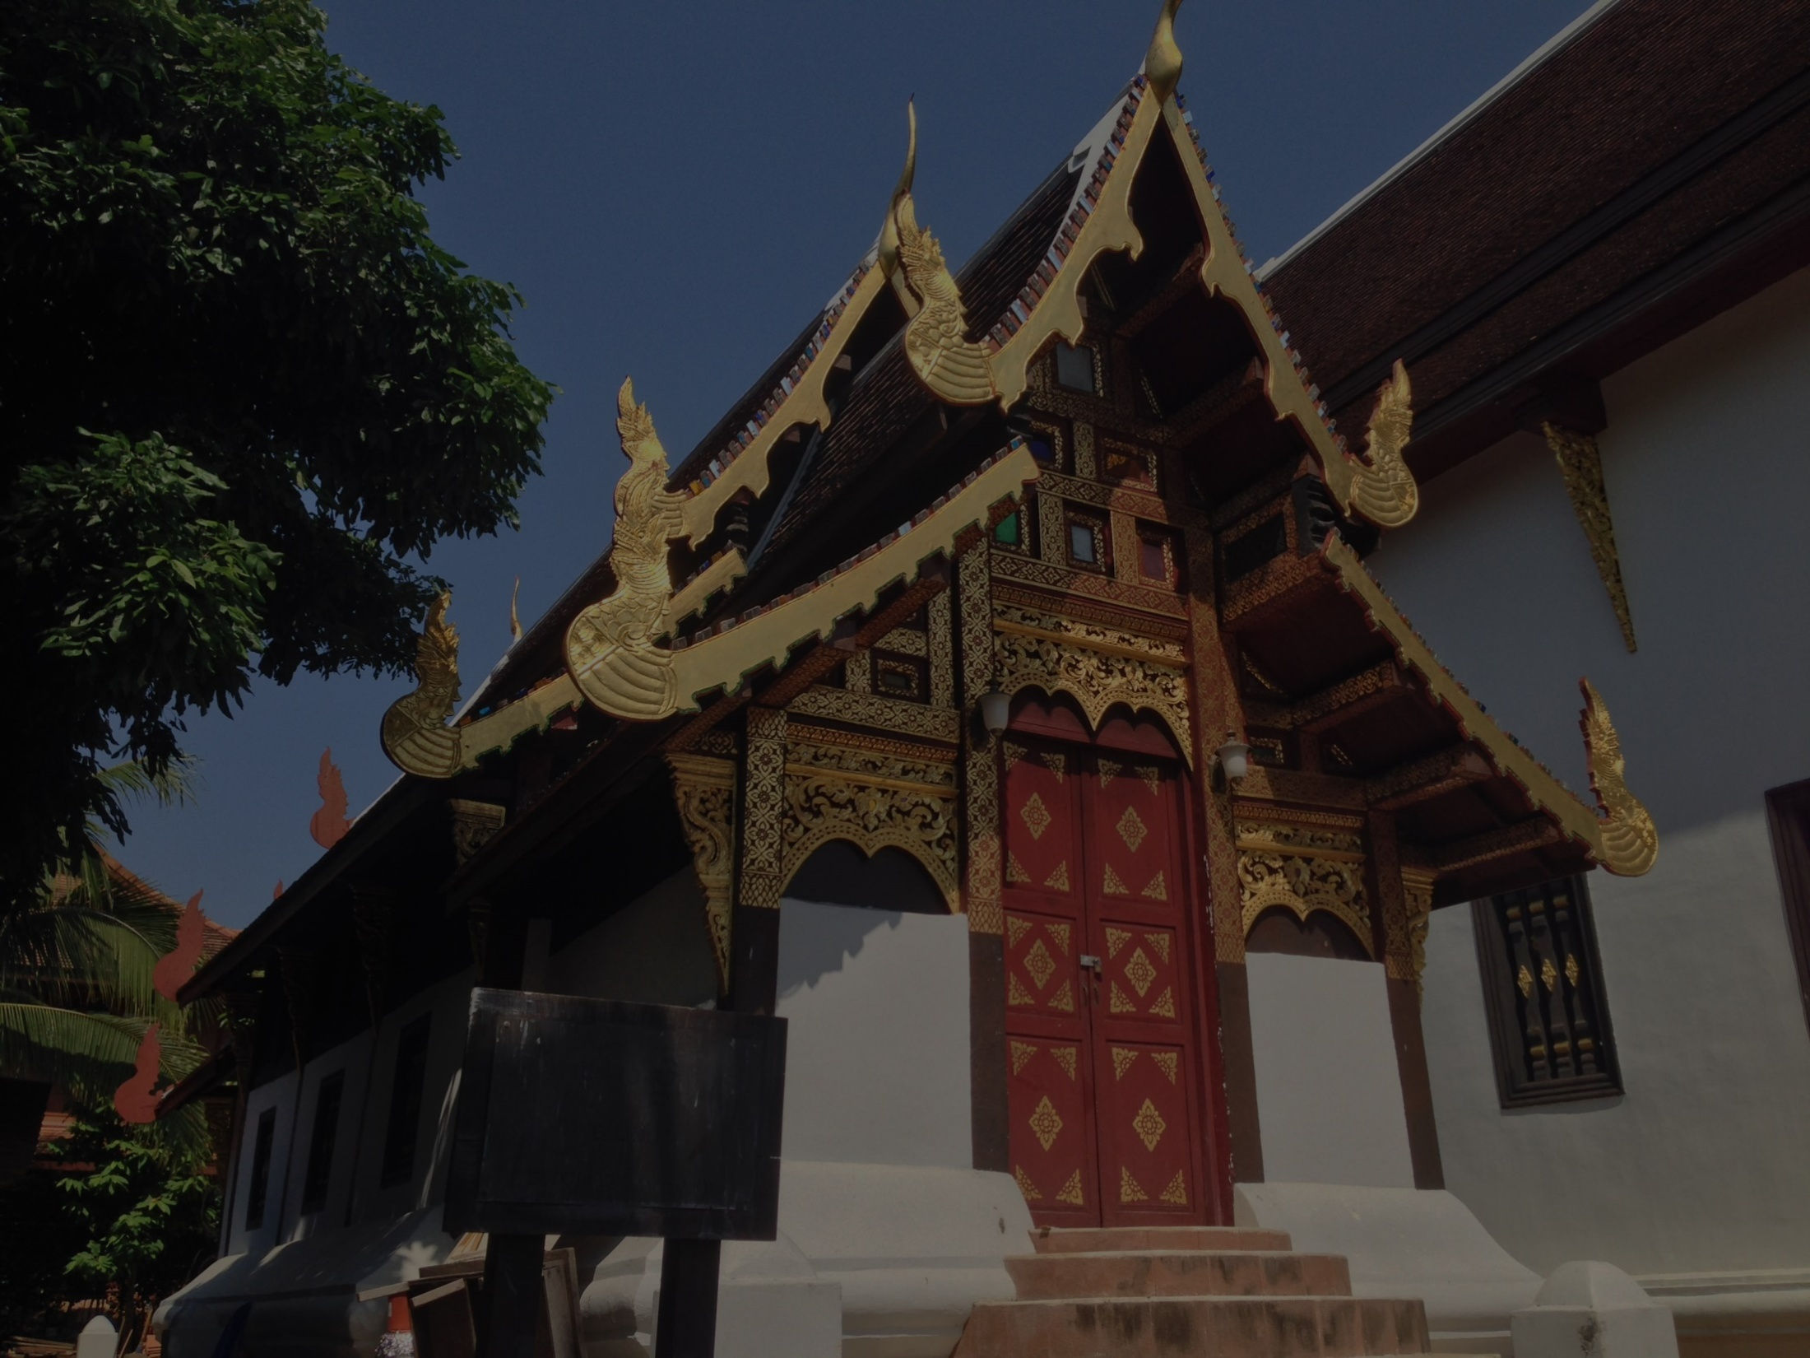
Sequence Diagram

Slide 10

Activity Diagram

Slide 11
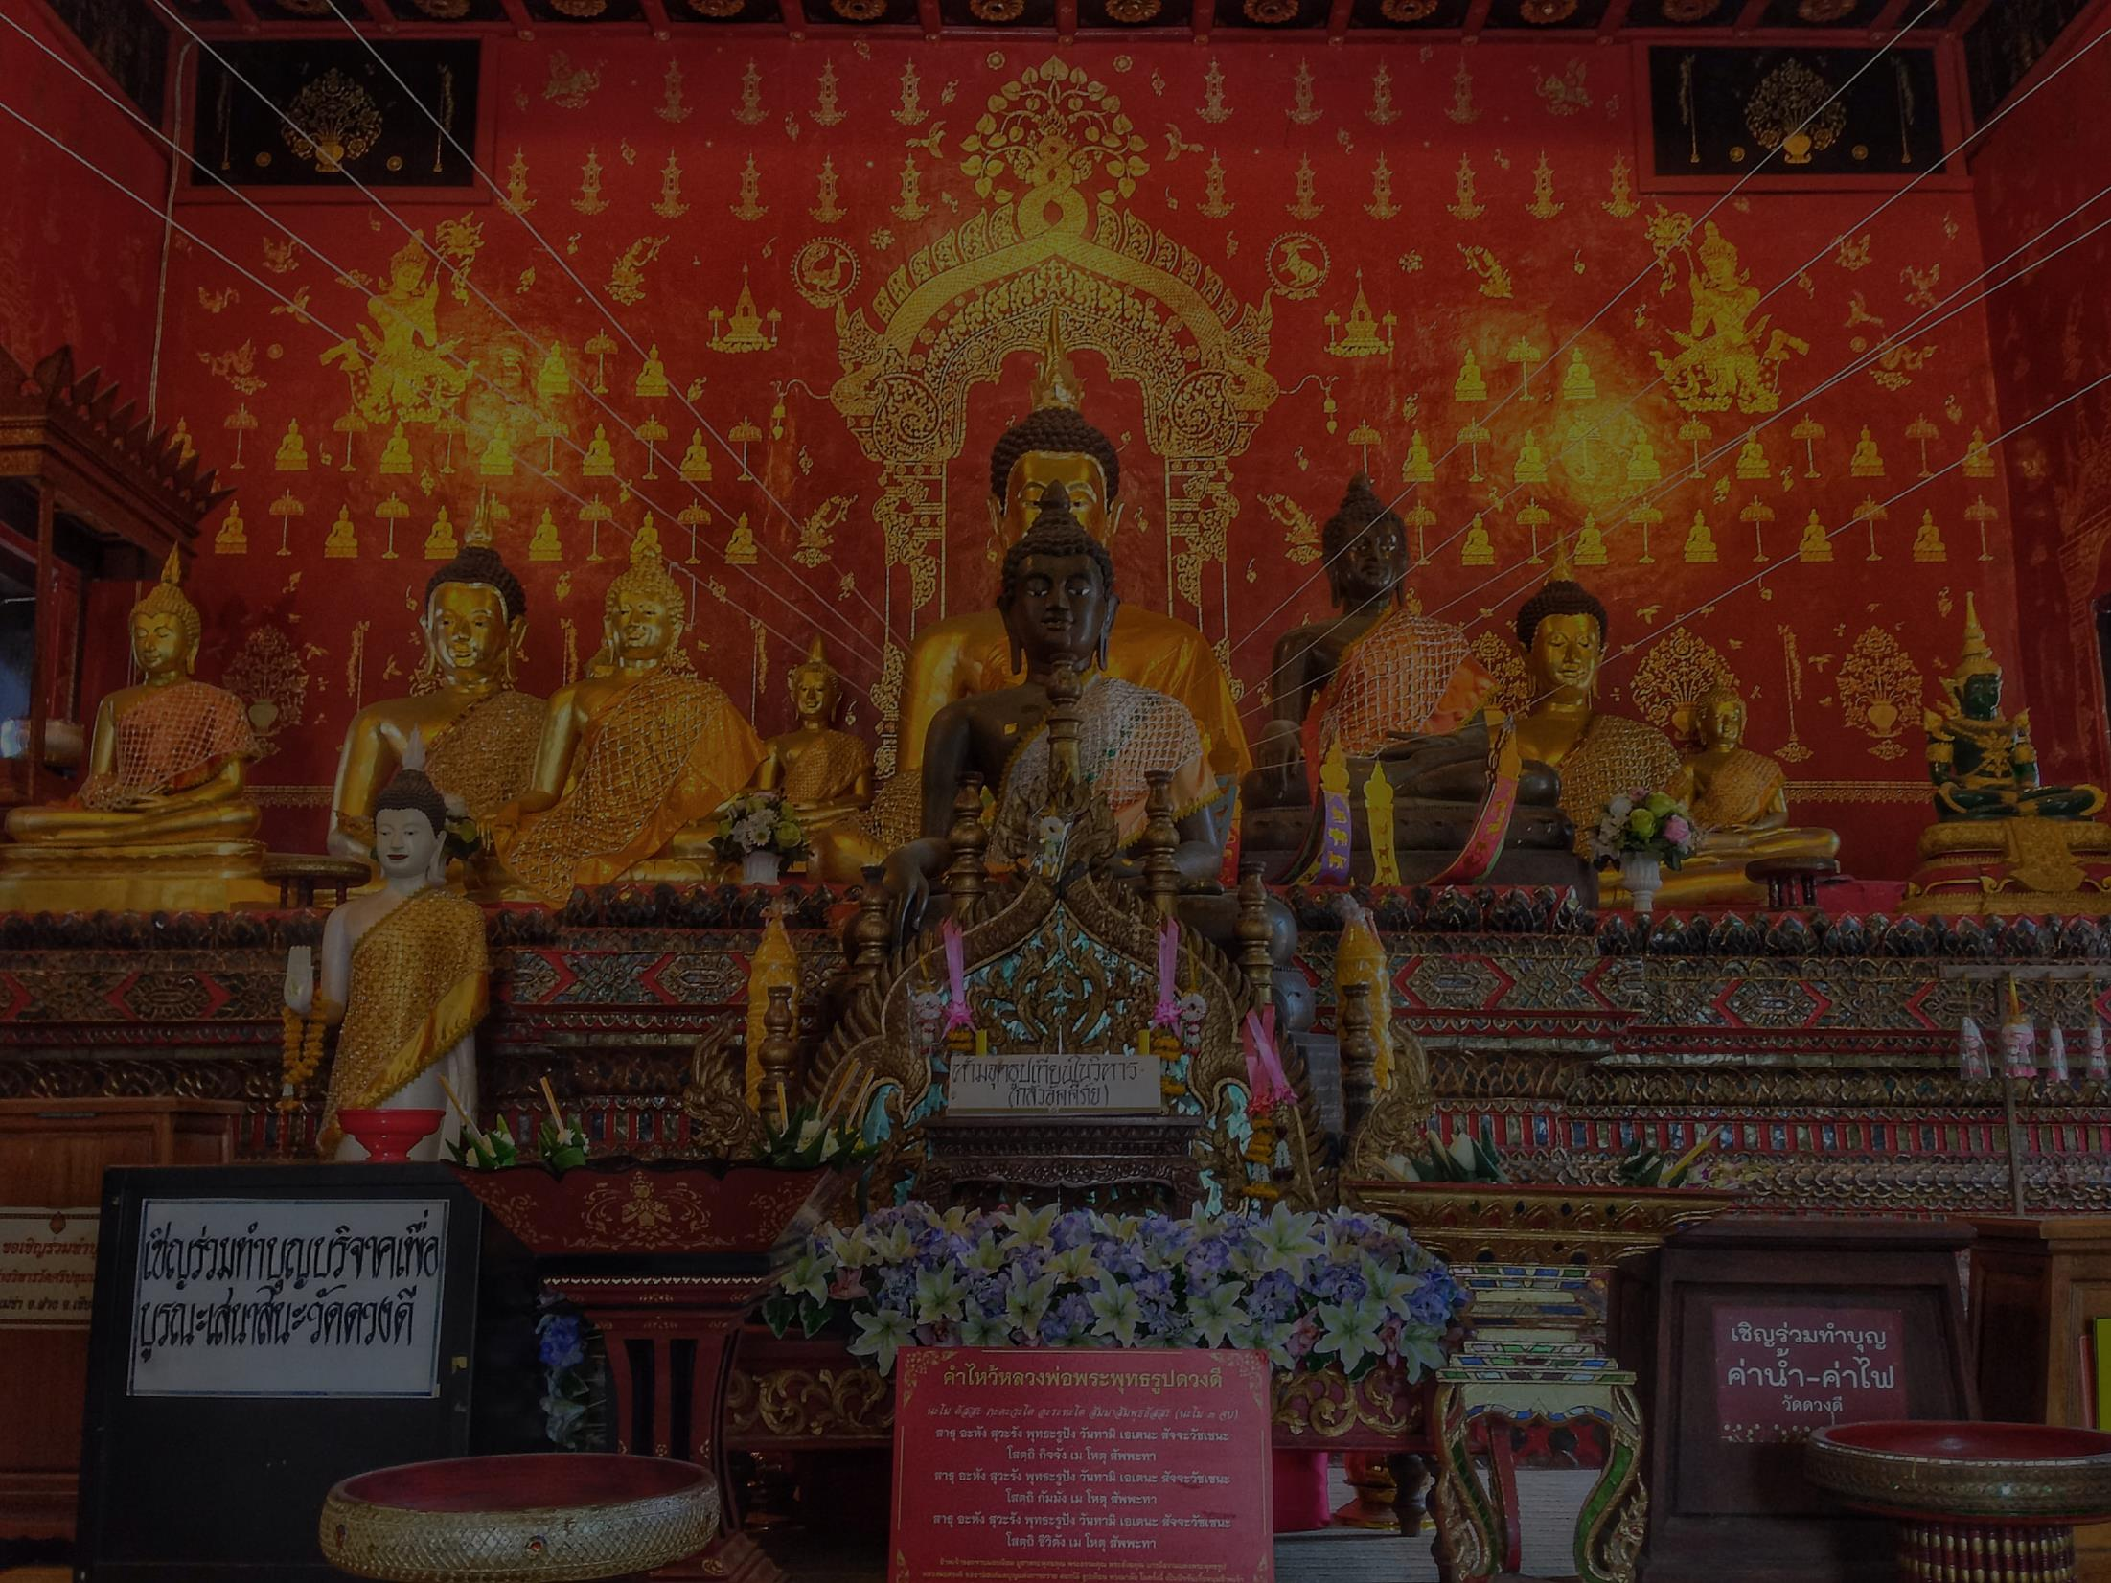
Method Design

Slide 12
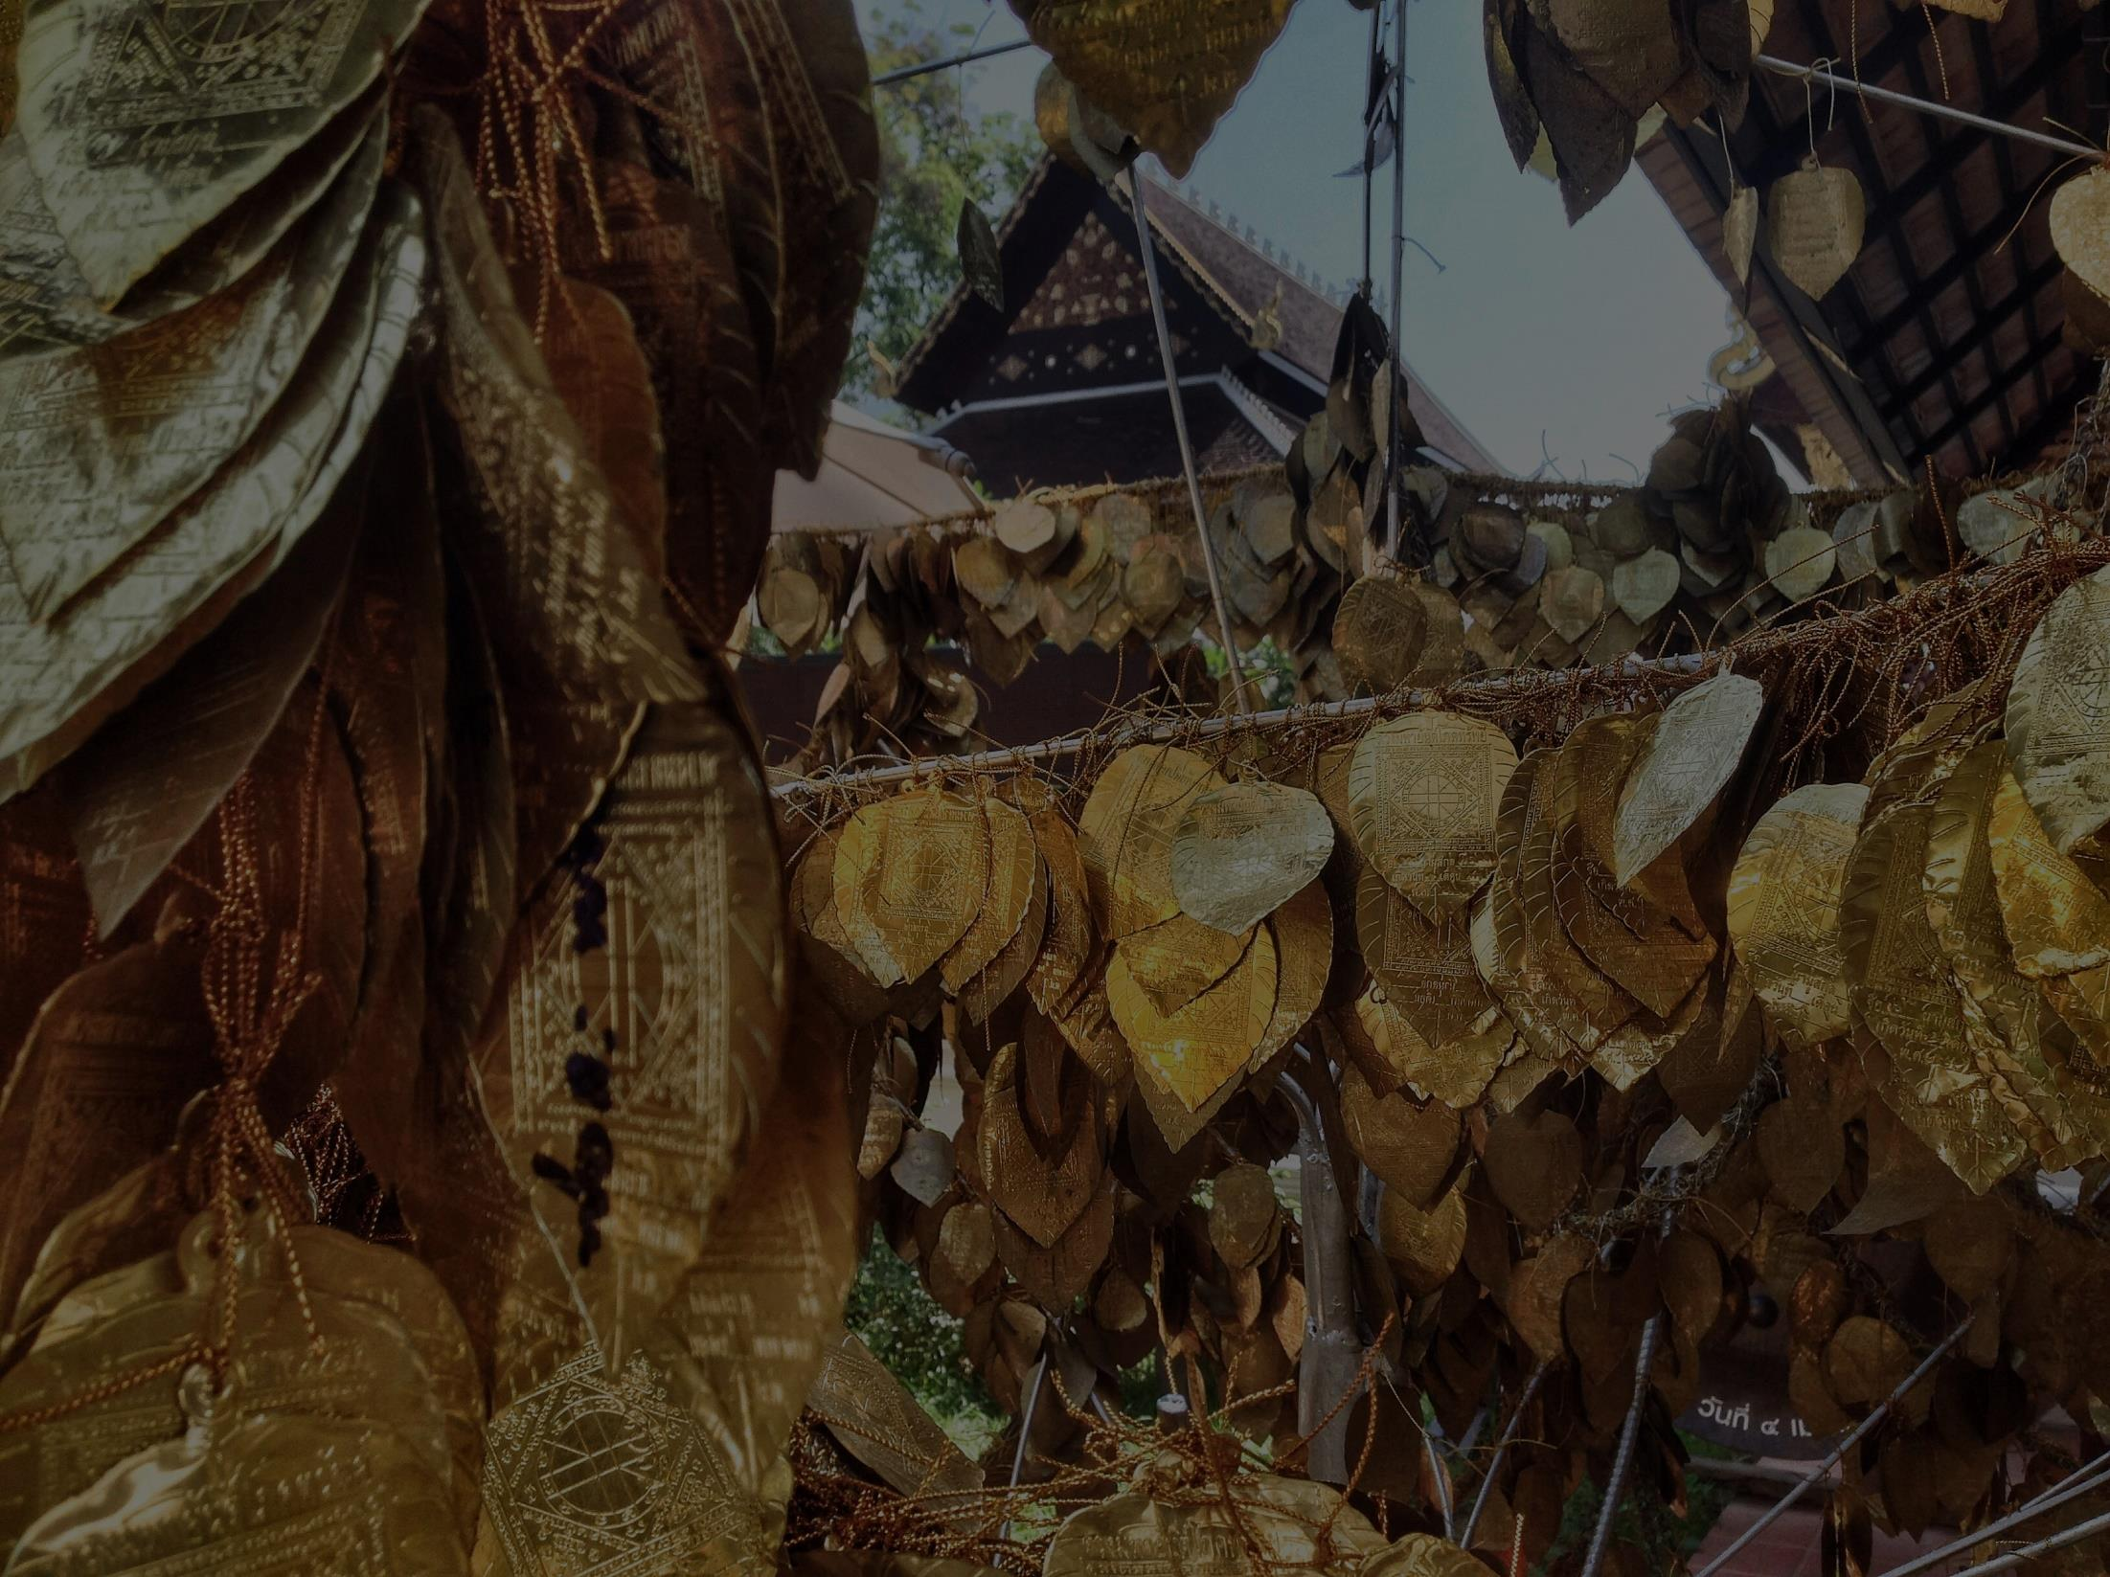
Traceability Matrix

Slide 13
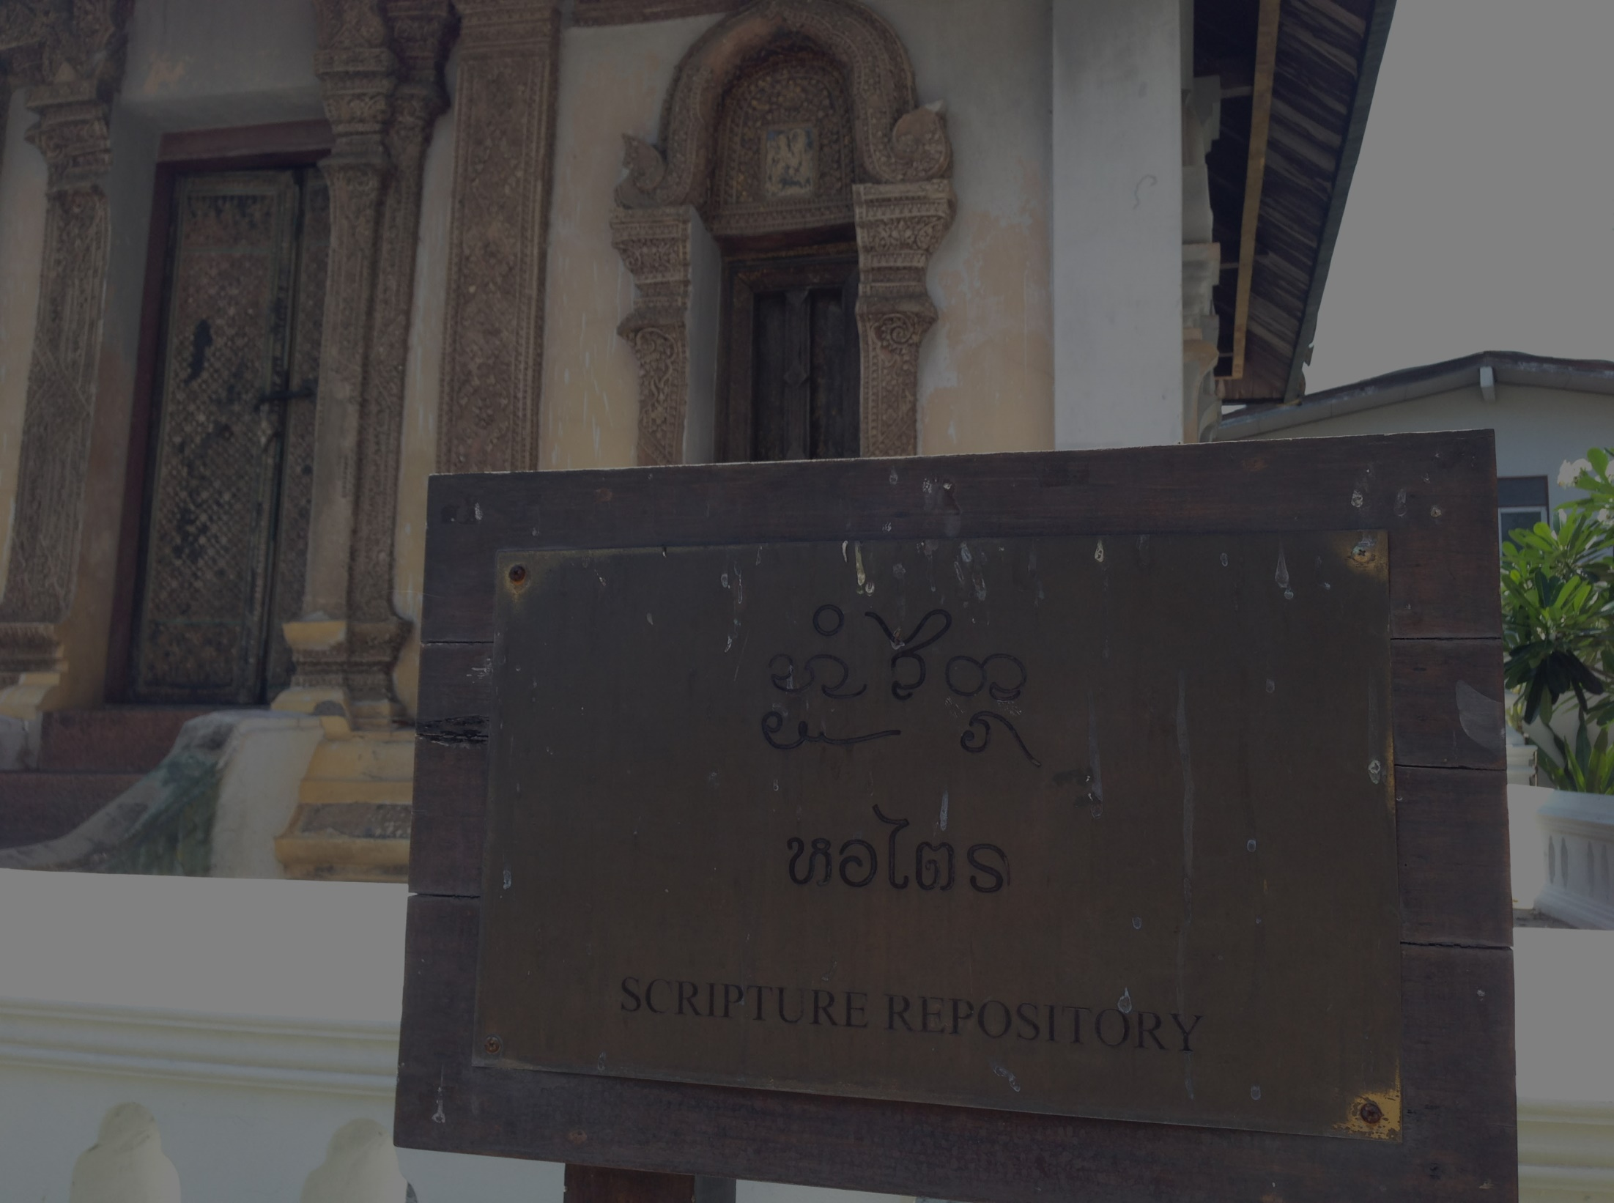
Prototype
Admin page: http://invis.io/MW2SYGN7G
User page: http://invis.io/6V2SYLAR4

Slide 14
Mile stone

Slide 15
Thank you very much
Q & A

